Slide 1
Assignment 1
Working with Edgar datasets: Wrangling, Pre-processing and exploratory data analysis
GAUTAM PAWAR
PRIYANJNA SHARMA
SUMIT DEO

Slide 2
Problem 1: Data wrangling Edgar data from text files
Goal: Parse and extract table data from Edgar 10Q and 10K filings using R/Python using the CIK and the accession number as inputs for a particular company.
Language Used: Python
Reference: https://www.sec.gov/Archives/edgar/data/51143/000005114313000007/0000051143-13-000007-index.html

Slide 3
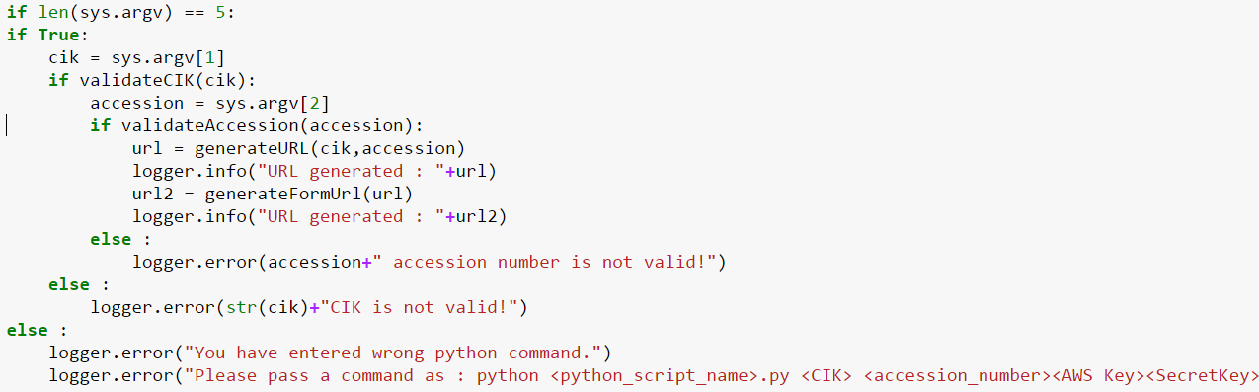
Step 1: Take input from user in the following order: Python Script Name, CIK_Number, Accession Number, AWS Key and Access Key on the docker terminal. Check for Validations like the number of arguments user has entered, CIK Number , Accession Number and AWS Key.
Part 1: Parse files

Slide 4
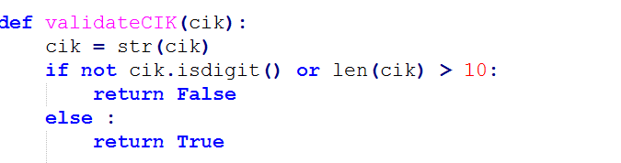
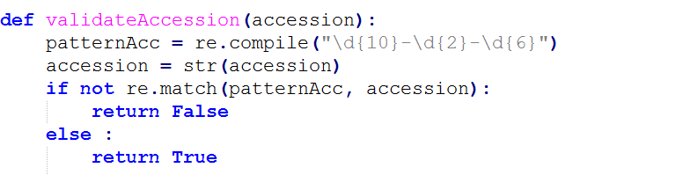
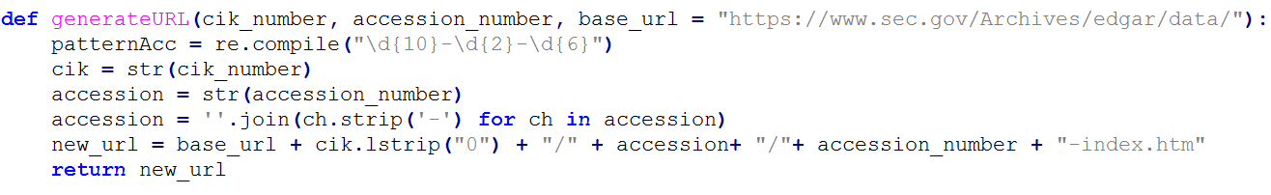
Step 2 : Validate CIK Number using number of digits(10) and data type(digit).
Step 3: Validate the Accession number using regular expression to check if it follows the proper format.
Step 4 : Generate the URL using the entered CIK and Accession number . This function will return the URL
that we will be appended in the URL to extract the tables.

Slide 5
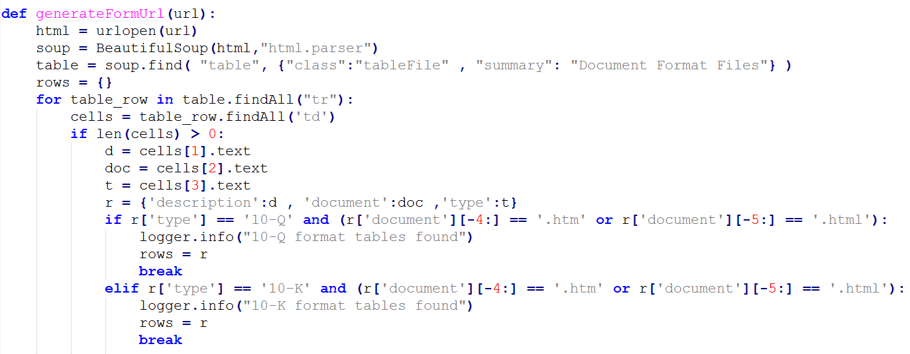
Fetching HTML content using Beautiful soup package.
Step 5 : Parsing through the html to find all the 10Q and 10K and logging the result.

Slide 6
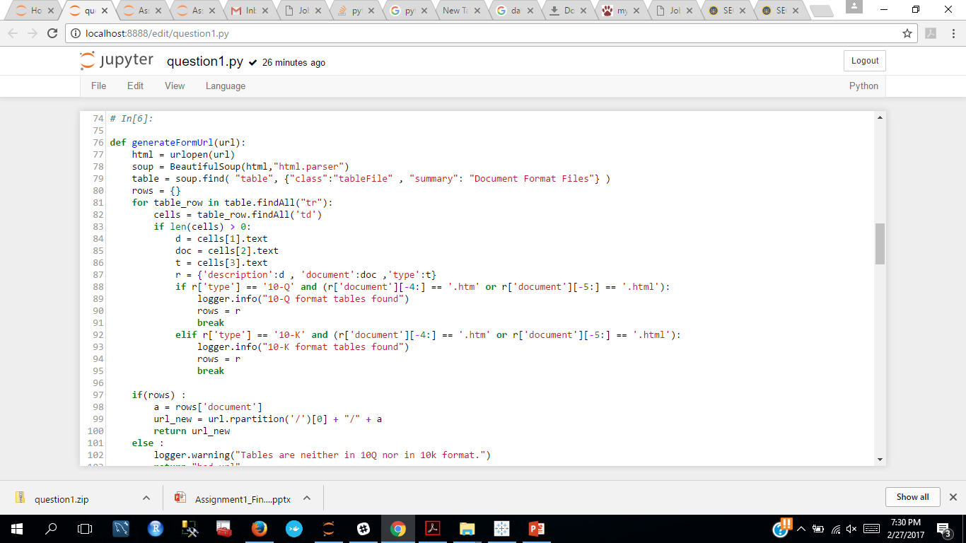
Step 6: Function generateFormUrl() :
Checks the main url for 10 Q or 10 K link based on the “type” column in table : Document Format Files
Generates the url of form 10Q or 10K which will serve as the source of scraping tables

Slide 7
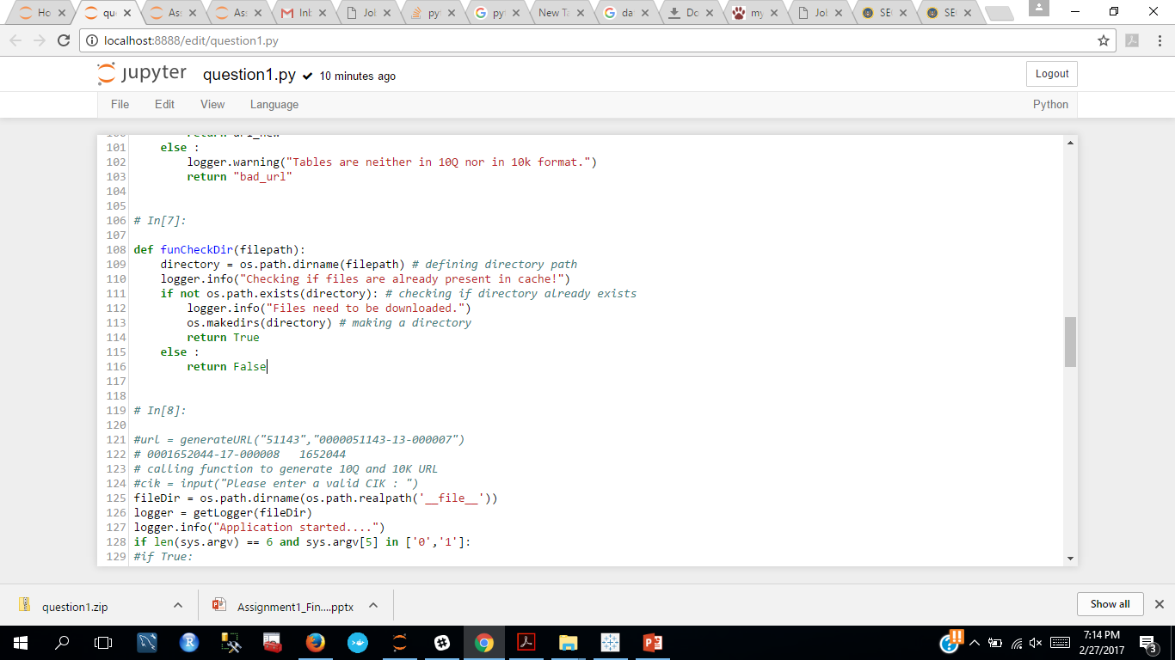
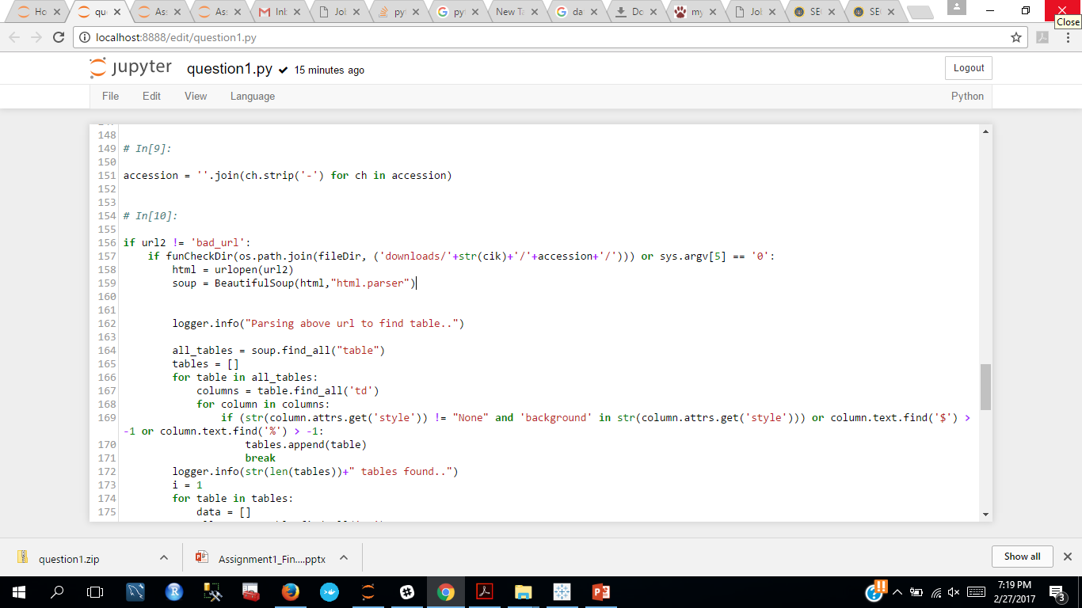
Step 7 : Function funCheckDir()
Checks if file is already present In cache
In case the files are updated at source : If present in cache , it asks if we want to use cache files or want to download new files

Slide 8
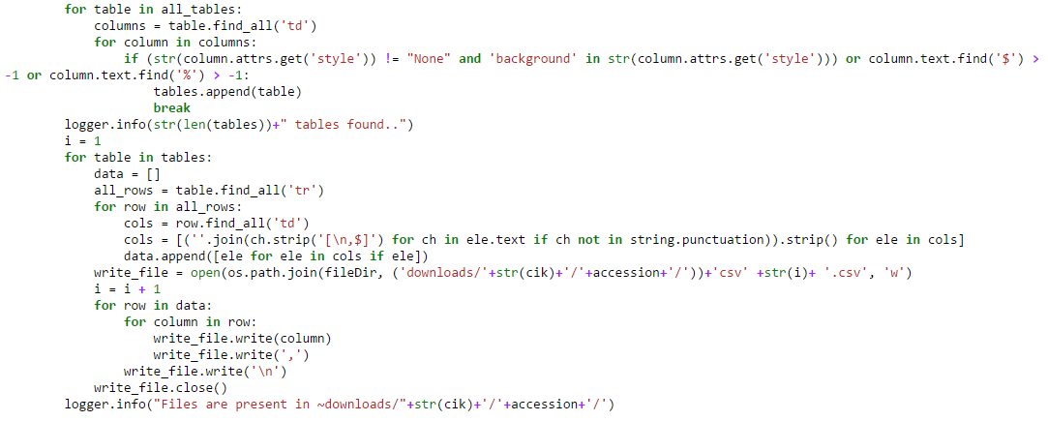
Step 8 : Scraping Tables :
Scraping through the form url to filter useful tables
We are filtering tables on the basis of “td” CSS Style –background color, symbols ($ , % ) to exclude non tabular data and non useful data.

Slide 9
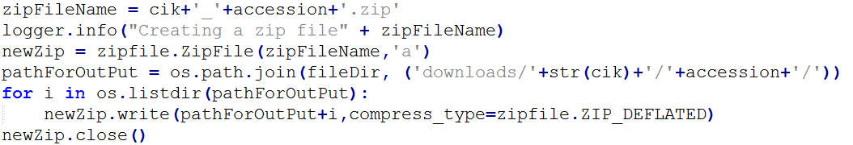
Step 9 : Performed data scrapping on the tabular data.
Step 10 : Defined relative download path of the csv files in the Docker container.
Step 11 : Zipping the csv files.

Slide 10
Part 2: Docker image to automate the task:
We have coded the parametrization in the python code so that user can enter all the parameters in a single go.
Pull the image from the docker hub.
Run the above pulled image.
Check for the container created using:
Run the container using the below command in the following format:
docker exec -it <container_id> python question1.py CIKNUMBER ACCESION NUMBER AWS_ID AWS_SecretKey 0/1 0 if you don’t want cache, 1 if you want cache

Slide 11
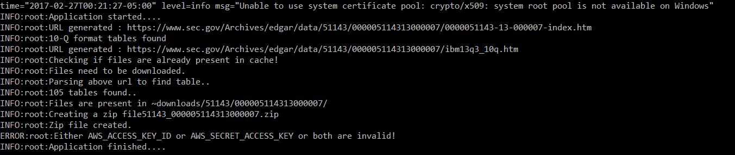
You will get the below log messages once you will enter the required parameters. We can check our AWS account to view the bucket created and analyze the data.

Slide 12
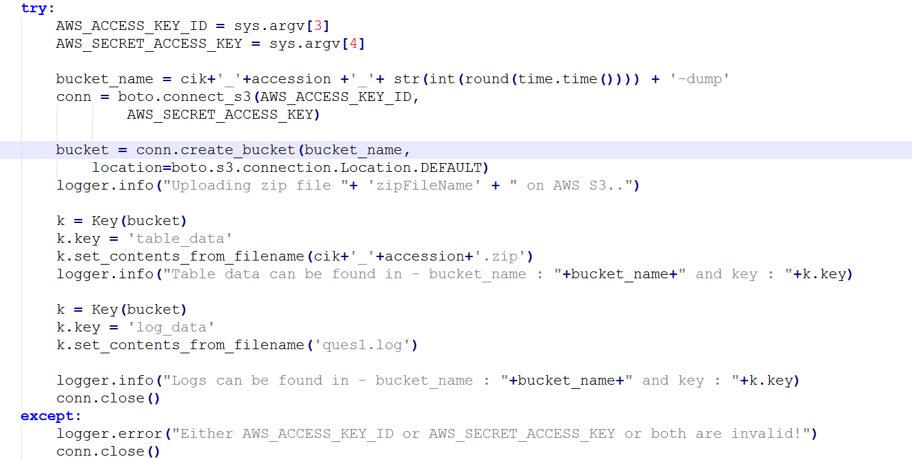
Python Code for connection with AWS S3 storage:
We’ll receive the AWS Key and ID through the user input in the docker terminal and create a bucket.
We have given the bucket name using CIK and Accession number.
In case user enters a wrong key or ID, he will get an error message stating invalid id or key.

Slide 13
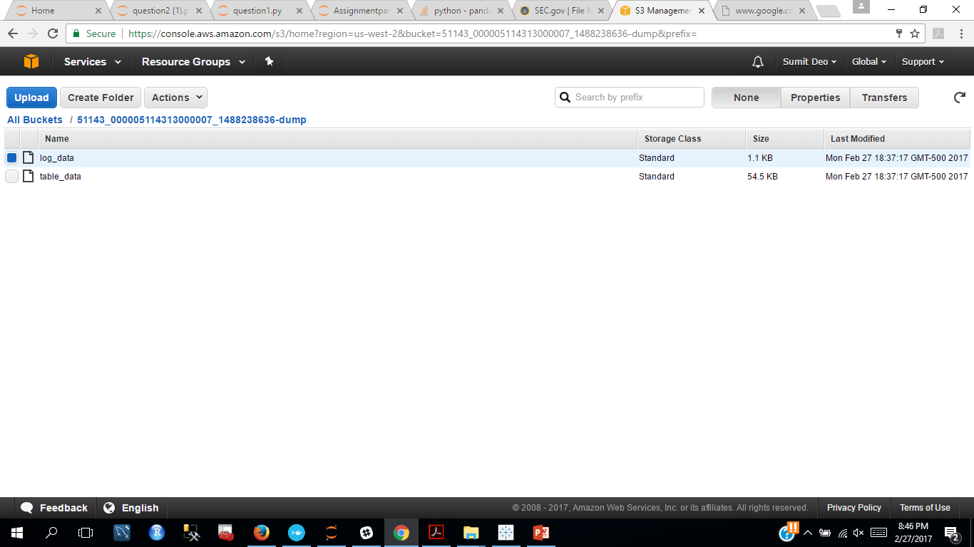
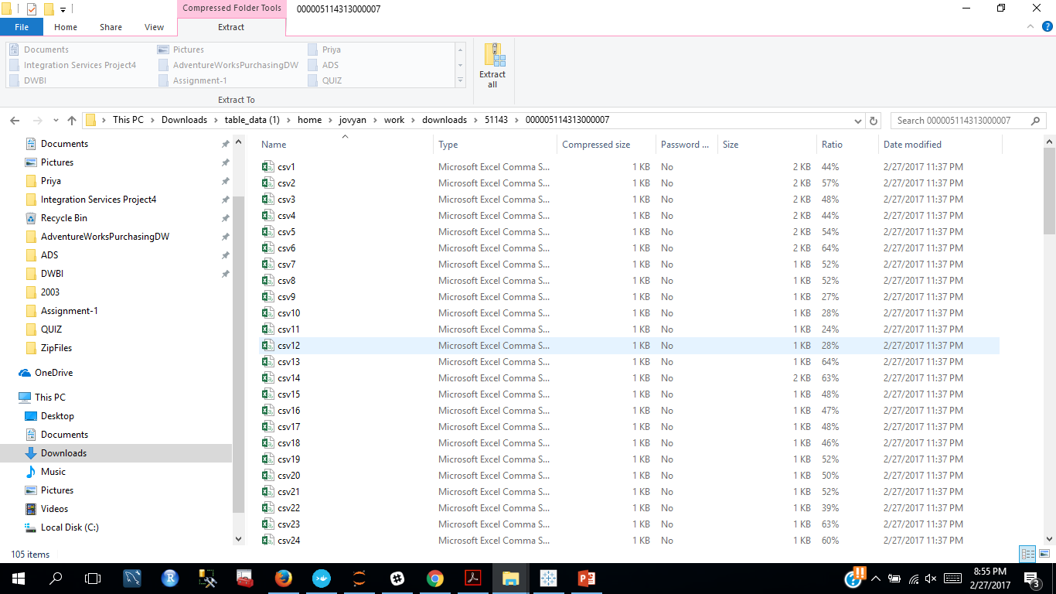
Example : checking uploaded data on Amazon s3
We uploaded log file and data that we zipped on amazon s3
Downloaded data that was uploaded on Amazon s3
Screenshot shows subset of files downloaded

Slide 14
Problem 2: Missing Data Analysis and Visualization (50 points)
Goal: To create a pipeline that accepts “year” as a input and download all log files for first day of each month in that year and process these files for:
Handle Missing data and Check for any observable anomalies
Compute Summary Metrics
Log all operations in a log file
Compile all the data and summaries of the 12 files into one file
Upload this compiled data file and the log file you generated to your Amazon S3 bucket (on R/Python packages to use for this
Visualization
Run Docker image for 2003 to generate outputs on S3. Analyze this data in a Dashboard on Tableau
Language Used: Python
Reference:
https://www.sec.gov/edgar/searchedgar/accessing-edgar-data.htm
https://www.sec.gov/data/edgar-log-file-data-set.html

Slide 15
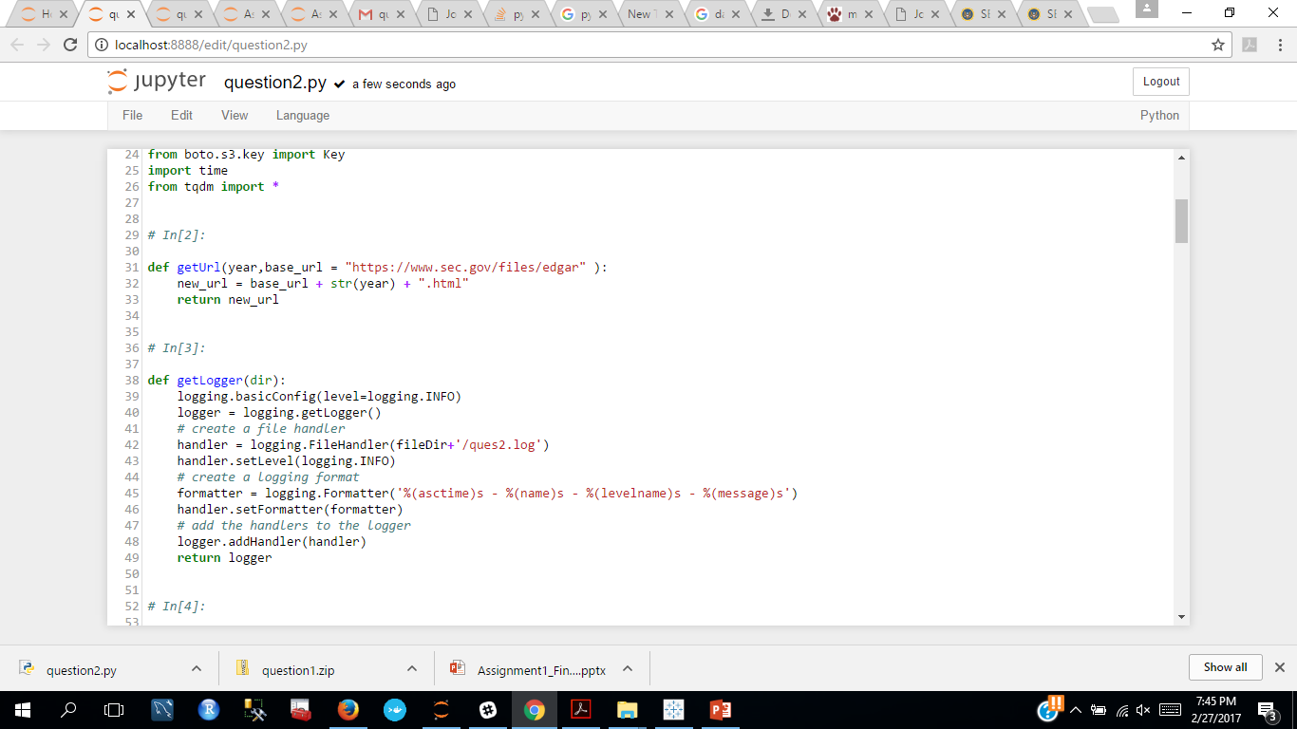
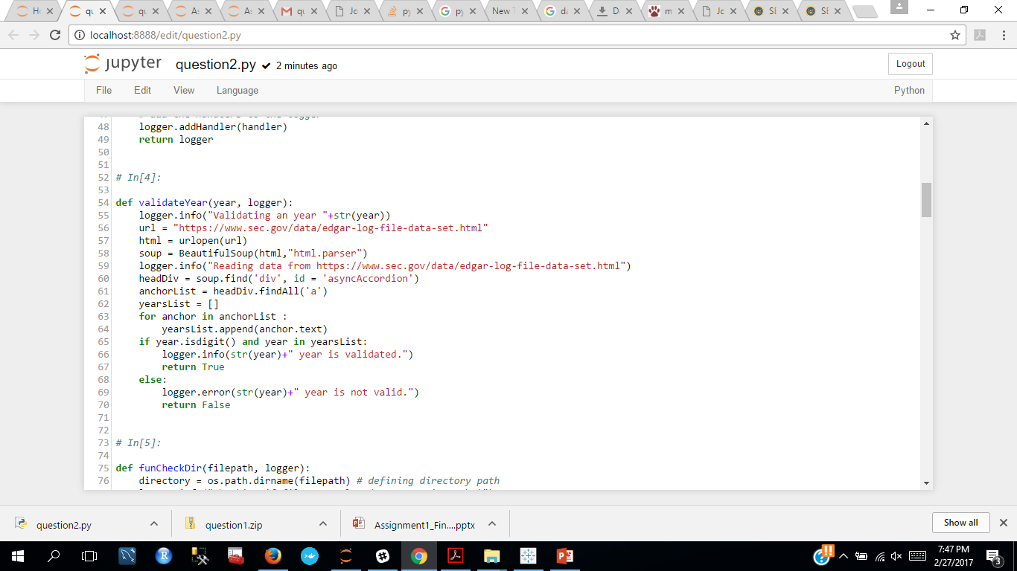
Step 1. Generate dynamic url and validate
Accept year as a input from user, validate it and create dynamic url to locate all the log files for that year
For example: if we input year as 2003 : url will be : https://www.sec.gov/files/edgar2003.html

Slide 16
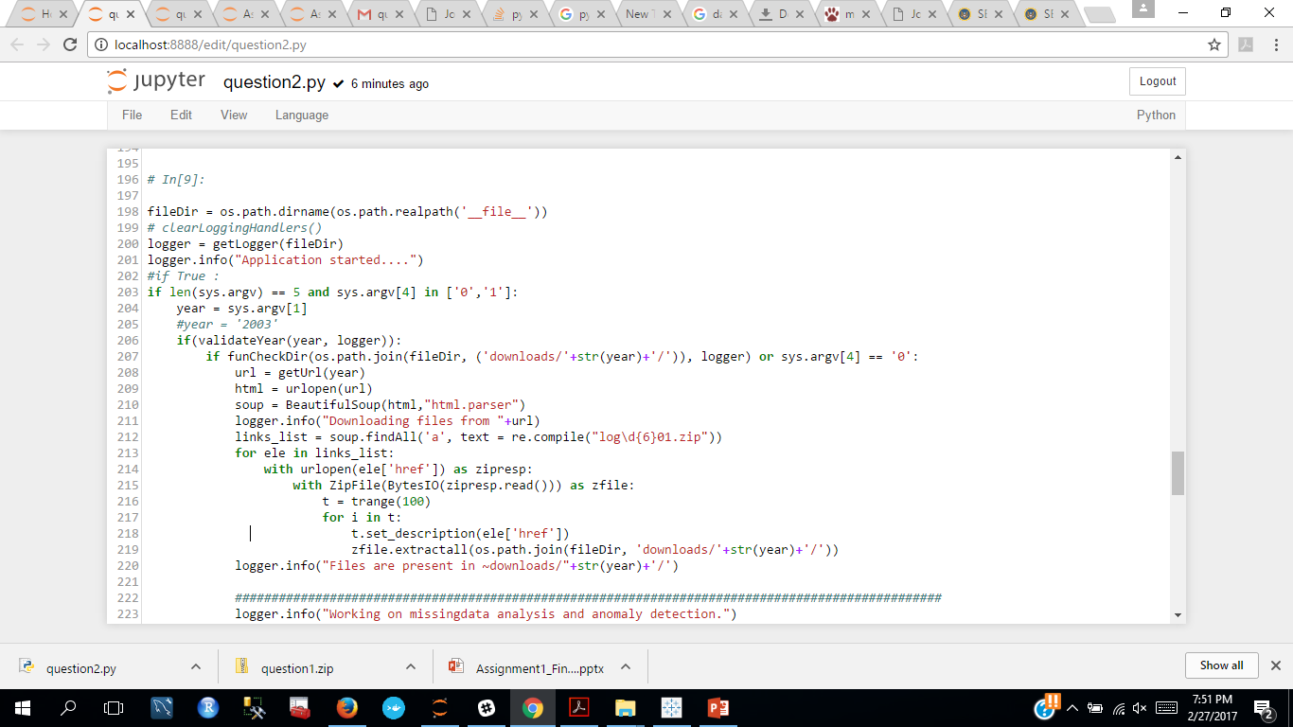
Step 2: Traverse url to extract log files for first day of each month
Traverse the generated url, log the data and locate the desired log files using regular expression validation to get all log files for first day of each month
If files are present in cache ; asks the user if it wants to download new data or use the cache file
Process Workflow: First check in cache if these files have already been downloaded ; If not then extract these files

Slide 17
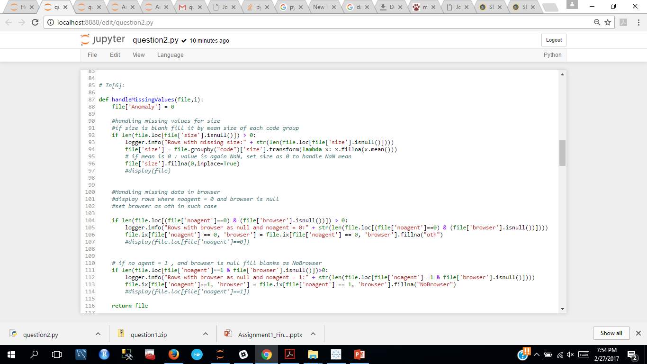
Step 3 : Handling missing data for each file using a function : handleMissingValues
handleMissingValues (file, counter) -Defined a function that accepts the file Data frame as an input and handles the missing values

Slide 18
Step 3 : Variables description considered for handling missing data and checking for anomalies
Code : Apache log file status code for the request
Size : document file size
idx : takes on a value of 1 if the requester landed on the index page of a set of documents (e.g., -index.htm), and zero otherwise
No agent : takes on a value of one if the Apache log file user agent field is empty, and zero otherwise
Browser : three character string that identifies potential browser type by analyzing whether the user agent field contained the following /[text]/ . Regular expressions are considered as described in the document
Crawler : This variable takes on a value of one if the user agent self identifies as one of the following web crawlers or has a user code of 404

Slide 19

Step 3.1 : Handling missing data for Size
SIZE - for missing values in the column size :
Group the column by code and replace size by mean size for each group
If the mean size is also 0 it is represented by Nan : to resolve this, replace these blank values by 0

Slide 20
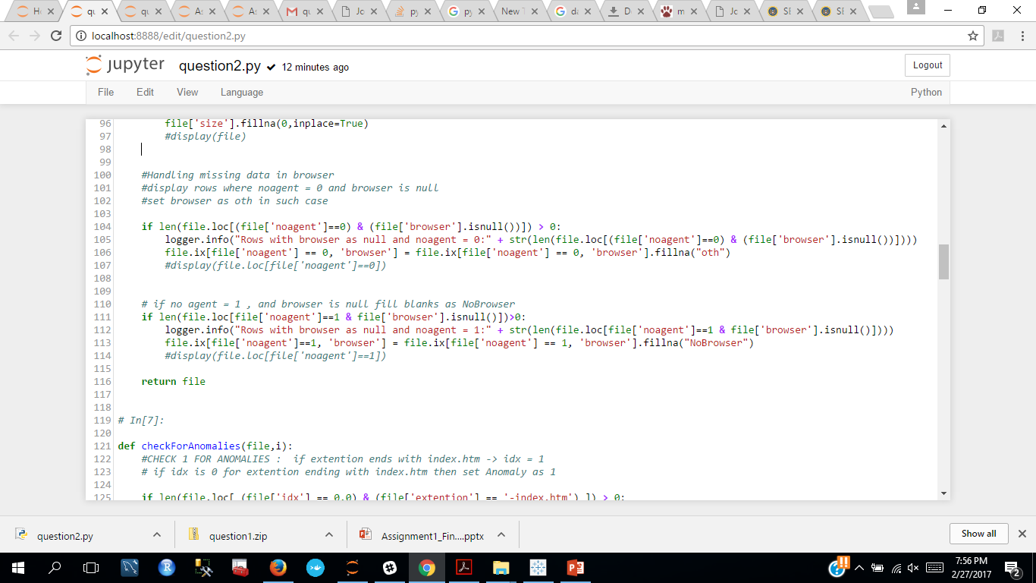
Step 3.1 : Handling missing data for Browser
Browser - for missing values in the column size :
As mentioned in the variables description of log files : no agent = 1 implies there is no user agent specified and vice –versa
When no-agent =0 and browser is null : we replace browser by “oth” as mentioned in the variables description
When no-agent =1 and browser is null : we replace browser by “NoBrowser”

Slide 21
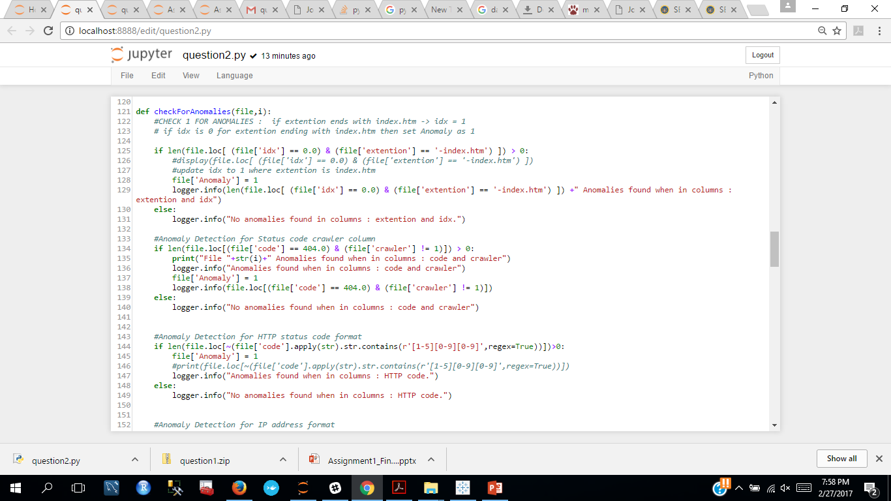
Step 4 : Finding Anomalies
Defined a function named : checkForAnomalies(file,counter)
It accepts the file data frame as an input and checks for any anomalies
Defined a new column called ‘Anomaly’ in the data frame
If any anomaly is found it is represented as 1 in the column ‘Anomaly’ else it is 0

Slide 22

Step 4.1 : Finding Anomalies in columns “idx” and “extention”
As per the description of variables if idx = 0 then file extention should end with index.htm as it depicts if the user landed on index page
If this condition is not met we depict it as an anomaly in the column – Anomaly by setting it as 1

Slide 23
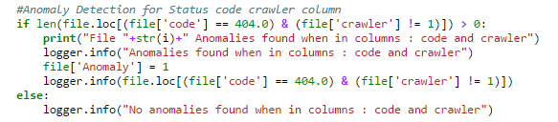
Step 4.2 : Finding Anomalies in columns “code” and “crawler”
As per the description of variables if code = 404 then crawler should be 1
If this condition is not met we depict it as an anomaly in the column – Anomaly by setting it as 1

Slide 24

Step 4.3 : Finding Anomalies in columns “code”
Here we are finding anomalies in code column by validating it against HTTP status code format by the regular expression - r'[1-5][0-9][0-9]'
If this condition is not met we depict it as an anomaly in the column – Anomaly by setting it as 1

Slide 25
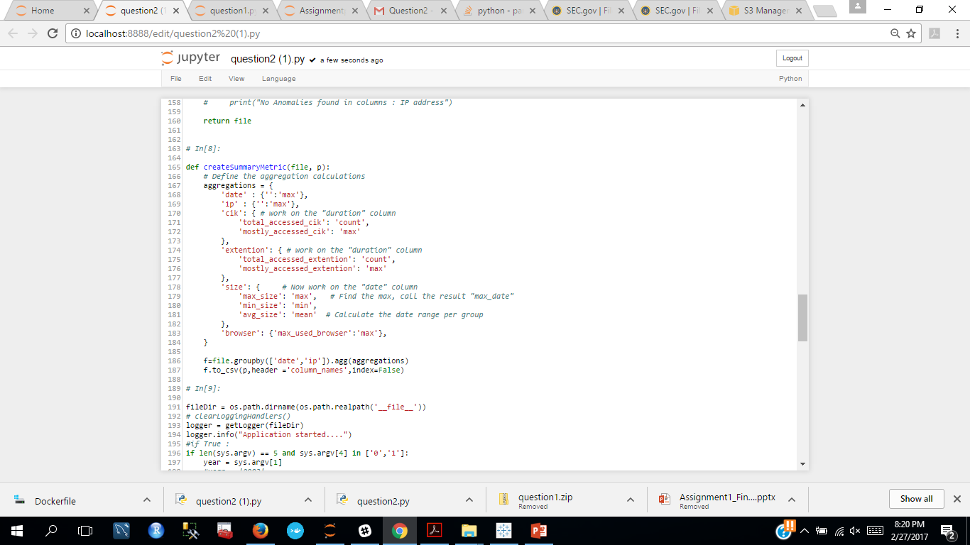
Step 5 : Defining Summary Metric
defined a function to calculate the summary metric for the entire year grouped by each month

Slide 26
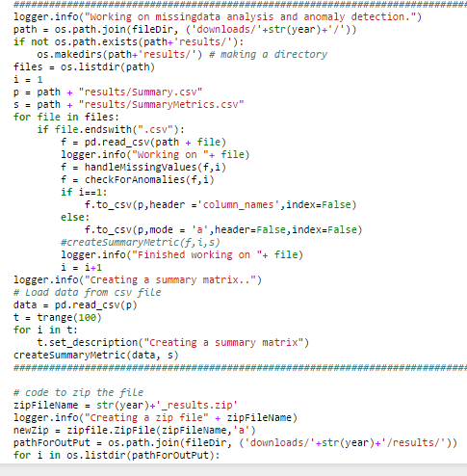
Final Workflow
Traverse the folder for the desired year and loop through each log file for the following:
Read file into a data frame
Call the function handleMissingValues() defined above
Call the function checkForAnomalies () defined above
Append the clean and updated data frame to a summary csv
Call the function createSummaryMetric() defined above
Zip the file and upload on Amazon s3

Slide 27
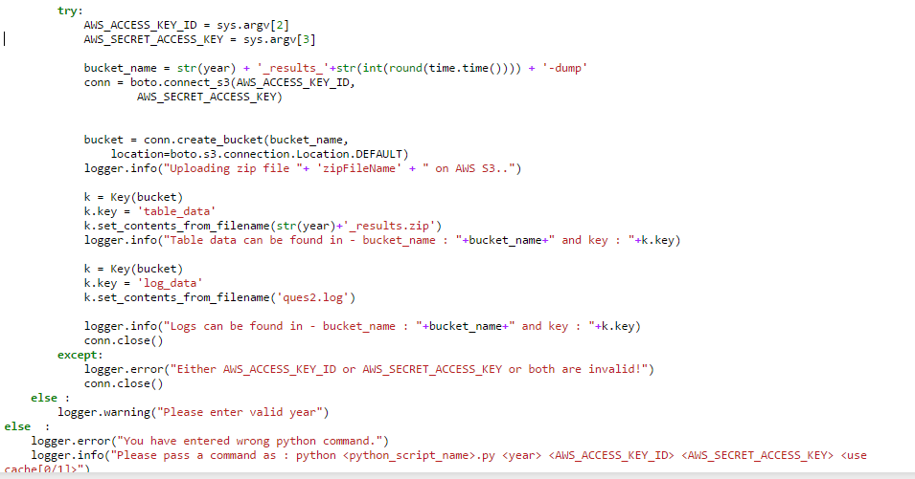
Python Code for connection with AWS S3 storage:
We’ll receive the AWS Key and ID through the user input in the docker terminal and create a bucket.
In case user enters a wrong key or ID, he will get an error message stating invalid id or key.

Slide 28
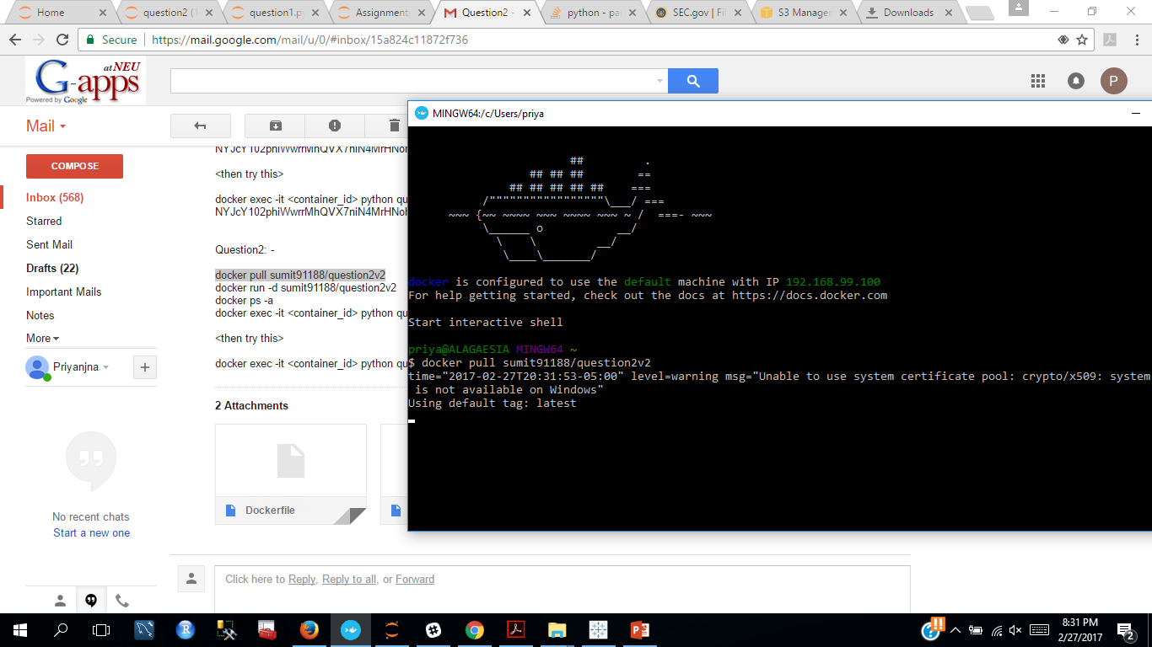
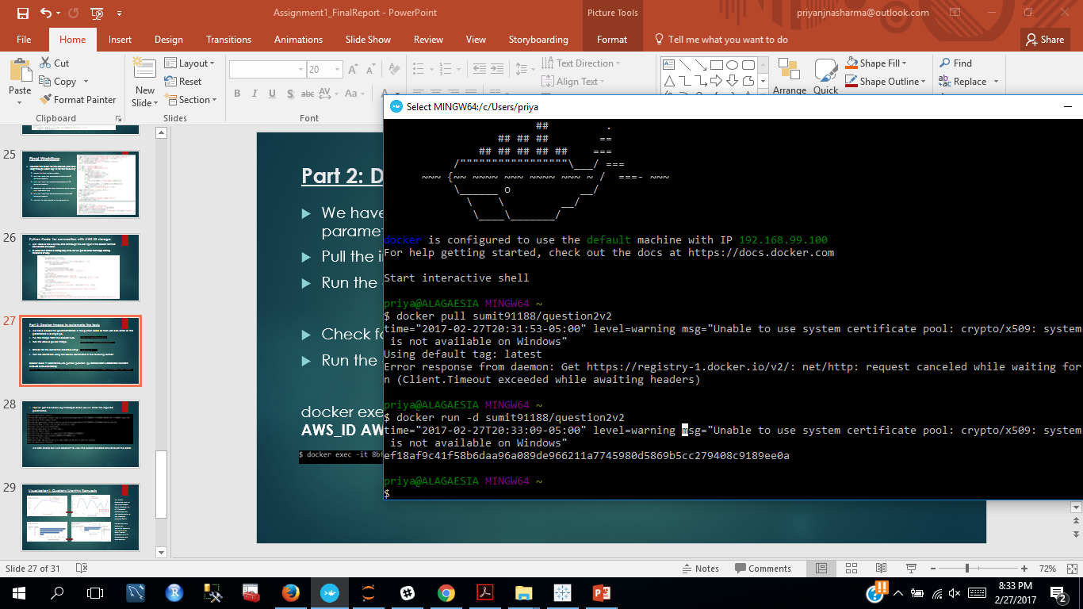
Part 2: Docker image to automate the task:
We have coded the parametrization in the python code so that user can enter all the parameters in a single go.
Pull the image from the docker hub.
Run the above pulled image.
Check for the container created using:
Run the container using the below command in the following format:
docker exec -it <container_id> python question2.py YEAR AWS_ID AWS_SecretKey CacheFlag(0/1) “0” – If you don’t want cache, “1” – if you want cache.

Slide 29
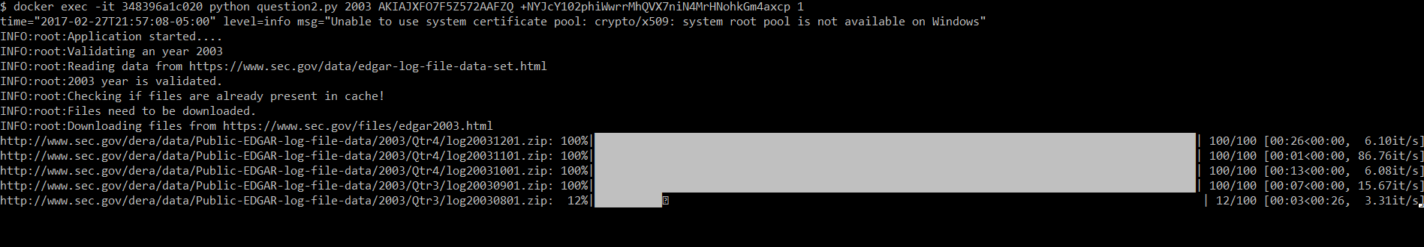
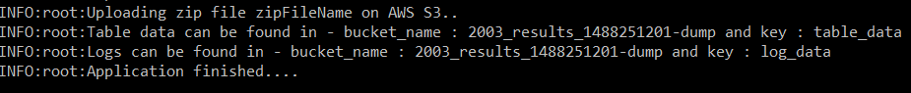
-- You will get the below log messages once you will enter the required parameters. -- We have implemented a progress bar that keep you updated about the progress of the file download -- Once the download has been finished, we can check our AWS account to view the bucket created and analyze the data.

Slide 30
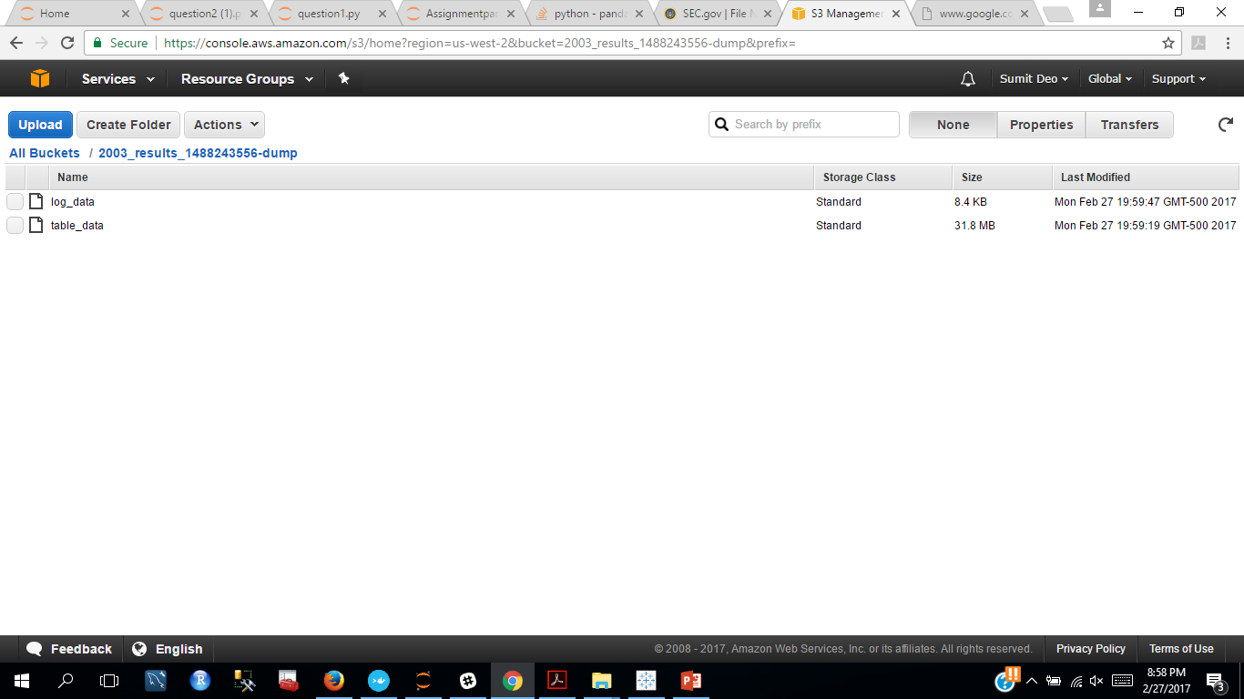
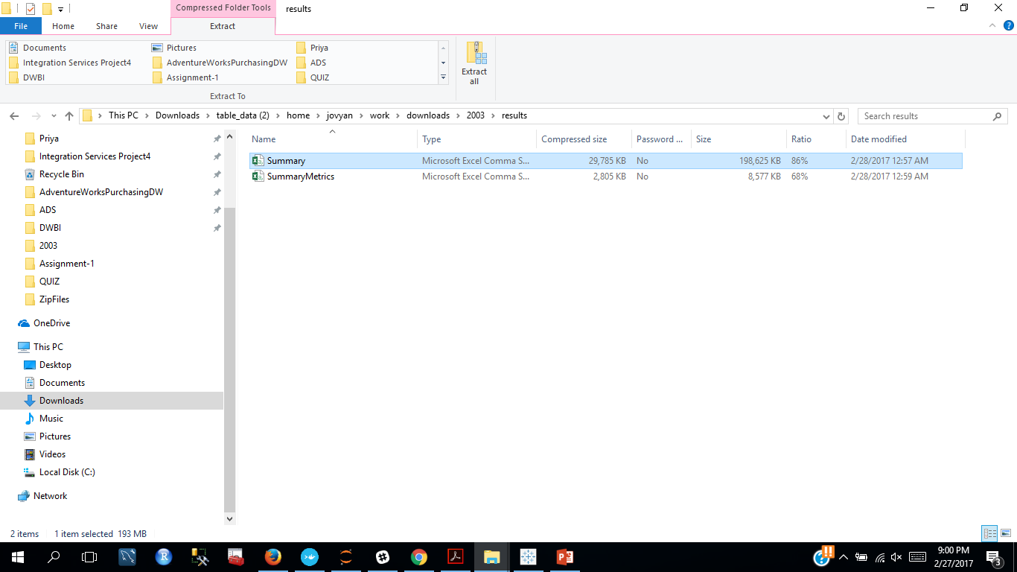
Example: Ran for 2003 and uploaded summary metric and zipped summary on Amazon S3
Uploaded the log file and summary metric on Amazon S3
The following files were uploaded in table_data
Summary: Combined all data for 12 months for 2003
SummaryMetrics : Calculated summarized data for 12 months for year 2003

Slide 31
Summary Metrics for 2003 on Amazon S3
Calcuated summary grouped by date and ip
Max browser used per “ip”
Total accessed extention: the document that was accessed most
Mostly accessed cik – count
Average file size grouped by date and ip
Total accessed cik –count
Min size of log file accessed
Max size of log file accessed
Snapshot of summary metric on next slide

Slide 32
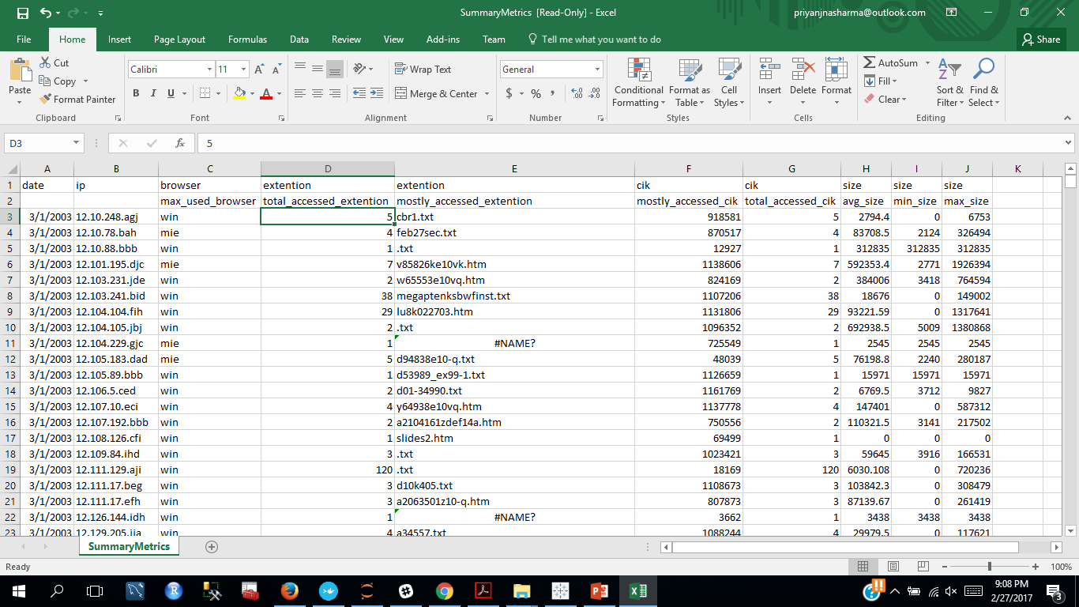

Slide 33
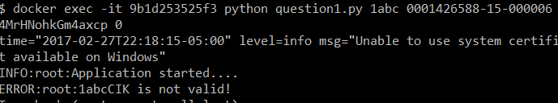
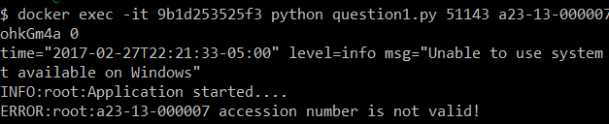
Exception Handling:
In case user enters invalid CIK or accession number.
In case user enters incomplete parameters
In case user enters invalid AWS ID or secret Key.

Slide 34
Visualization:
Ran problem 2 for year : 2003
Analyzed the summarized data uploaded on amazon s3 on tableau

Slide 35
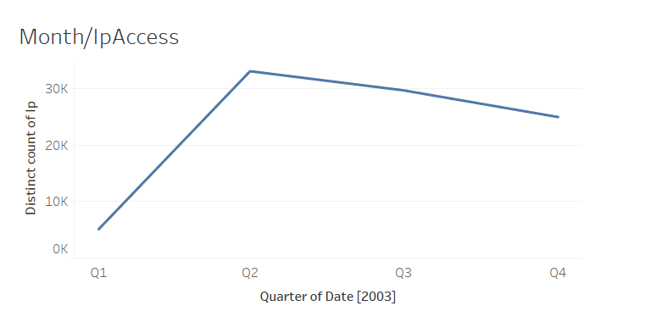
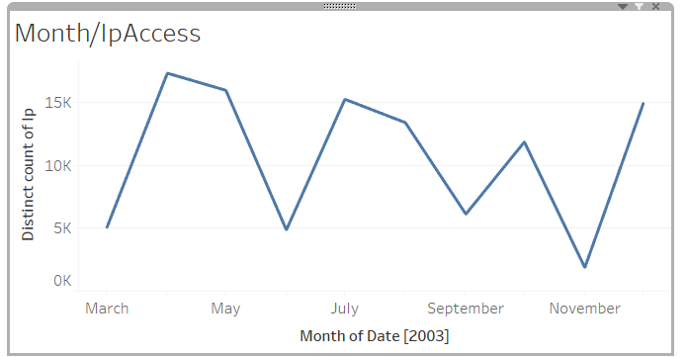
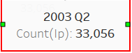
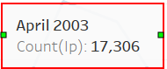
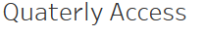
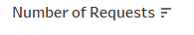
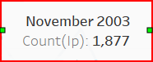
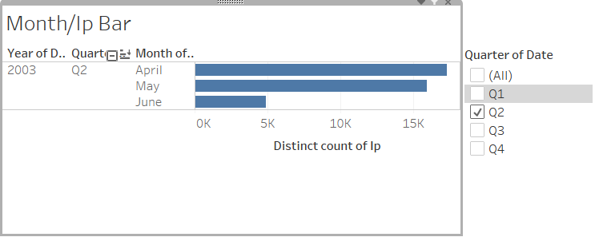
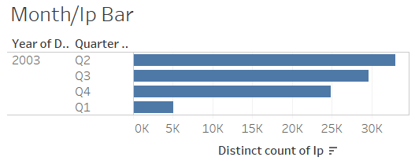
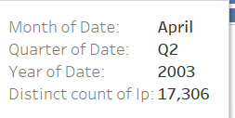
Visualization1: Quaterly/Monthly Requests
We have analyzed that in the year 2003, most number of IP’s (33,056) requested for the document in the second quarter (Q2).
Further drilling down on monthly basis, in the month of April , most number of IP’s requested the document.

Slide 36
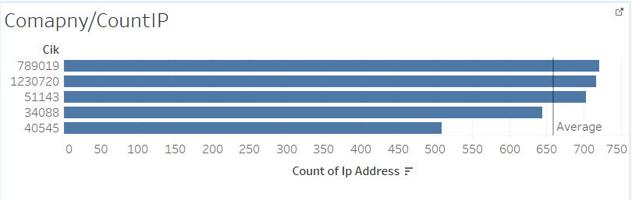
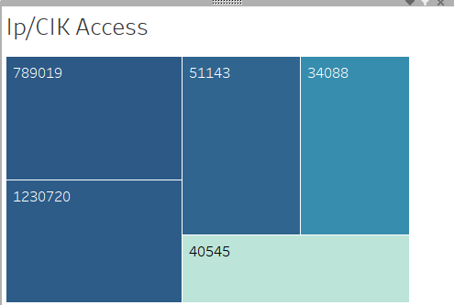
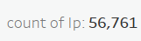
Visualization2: Most number of Company’s Documents Requested
We have analyzed the total number of IP requests on a particular (CIK) i.e. company’s document(10Q or 10K).
Recorded the top 5 ranked in the descending order of the requests.
Heat map on the left shows that the majority of the documents requested were related to below companies.
Results are as:
Rank Company Name CIK
1 Microsoft Inc. 78901
2 International Business Machines Corp 51143
3 EXXON MOBIL CORP 34088
4 LETKO, BROSSEAU & ASSOCIATES INC 1230720
5 General Electric Co 40545

Slide 37
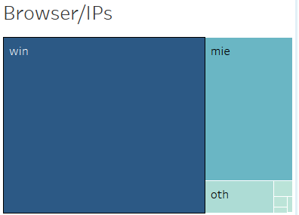
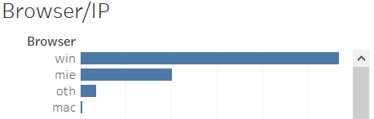
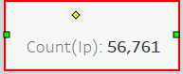
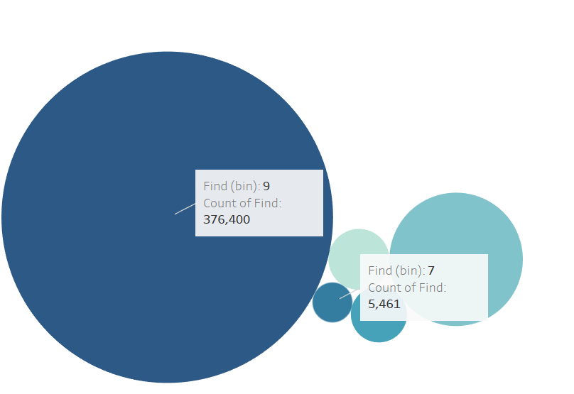

Visualization 3: Navigation Requests Classification:
We can infer that most number of requests were made by the windows browser (56761 times) and the least was mac.
We have considered find attribute in the csv that describes the navigation method through which the IP has accessed the document .
Most number of IP’s (376,400) have accessed the documents using type 9 i.e Using the index.html web link.
Least number of IP’s (5,461) have accessed the documents using type 7 i.e. using the Edgar Archives .

Slide 38


Visualization 4: Binning the IP Requests on the basis of Requested Time:
Based on the unique count of number of requests by IP’s, we have created a different buckets on the basis of time periods namely 6am to 12pm, 12pm, 6p, 6pm to 12am etc. and found out .
It is evident from the below figures, that 12pm to 6pm bucket was the busiest time(36,287 requests) when IP’s requested for the document and the least was 6pm to 12 am bucket(15,009)

